Slide 1

Azure App Service
以Azure App Service 建立服務行動應用+網站應用的 API Apps 服務
陳葵懋 Ian Chen
http://codeian.idv.tw/

Slide 2
Agenda
Azure App Service
HOL - Create an app with a mobile and web client in Azure App Service

Slide 3
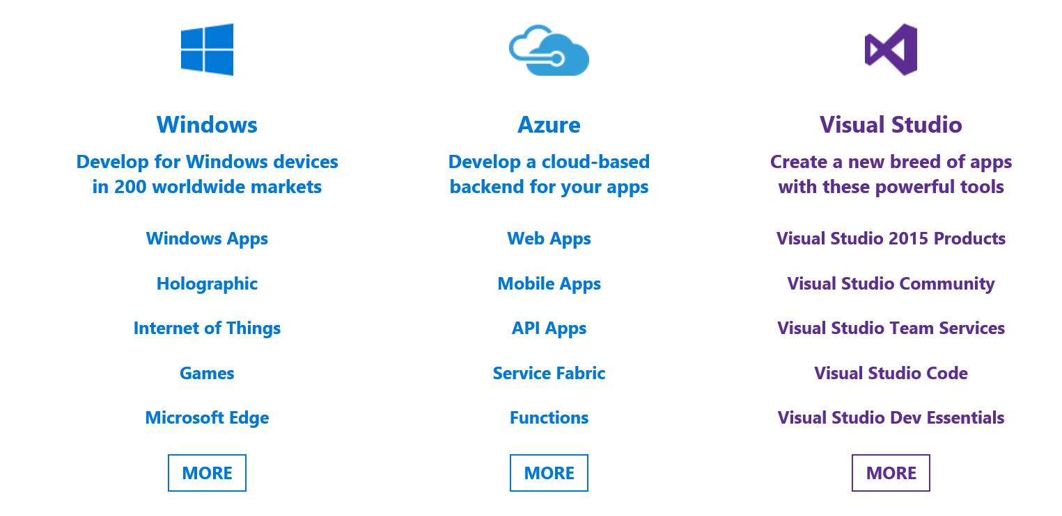

Slide 4
API
Service
Data Base
Server
PC
Web
Server
Mobile
App
Azure App Service
C#、Java、PHP、Node.js 和 Python

Slide 5


App Service
Web Apps
Mobile Apps
Web apps that scale with your business
Build Mobile apps for any device
LOGIC Apps
Api Apps
Automate business process across SaaS and on-premises
Easily build and consume APIs in the cloud

Slide 6
Azure App Service
Web Apps
Web 應用程式(ASP.NET,WordPress,Web+MySQL…..)
Mobile Apps
User Authentication (Facebook,Twitter,Google,Microsoft,AD)
Push Notifications
Off line Store
API Apps
建置和取用雲端 API
Logic Apps
視覺化設計工具，將商務程序執行和工作流程自動化

Slide 7
App Service
Azure Managed OS Updates
.NET、Java、PHP、Node.JS 及 Python
Scale Out / Scale Up

Slide 8
Hand on Lab
Use Azure Portal Create Azure App Service
使用Visual Studio 2015 建立 Azure API Apps 專案
Swagger
發行Azure API Apps

Slide 9
參考資源
https://azure.microsoft.com/zh-tw/services/app-service/
https://azure.microsoft.com/zh-tw/documentation/articles/app-service-value-prop-what-is/

